Slide 1

AUTOMATED STREET LIGHTS
An Arduino powered street light system which can sense objects and provide lighting as required. This falls under the SMART CITY problem statement given in the EoT Hackathon 2023

Slide 2
Problem Statement
Despite street lighting being an essential component of urban infrastructure, it accounts for a significant portion of India's overall electricity consumption. Inefficient lighting technologies and poor maintenance practices contribute to unnecessary energy consumption and wastage, leading to higher electricity bills, increased greenhouse gas emissions, and strain on the country's energy resources. Therefore, there is a need to address the issue of energy wastage in street lighting systems and implement more efficient and sustainable solutions to reduce the environmental impact and improve the energy efficiency of urban infrastructure in India.

Slide 3
HOW CAN IoT BE INVOLVED IN IT?
Consider a situation when an emergency vehicle like Ambulance passes on a road where our smart street lights are installed. How will the lights act for it?
The cameras installed on the poles, will constantly check for vehicles with hazard lights on, and if detects any, it will turn on all the leds for a certain distance intervals for a smooth flow of the vehicle.
These cameras will also record the average number of accidents happening on these routes and will mark accordingly on maps based on the results. This will help the drivers know if a certain area is accident prone zone or not even before they arrive at the place to look for a NHAI warning boards.

Slide 4
ORIGINALITY OF THE IDEA
Originality in Adaptation: Innovative Solutions to Address Energy Wastage in Street Lighting Systems in India
Detects Objects
The Light triggers itself when an object reaches at a specified distance
Variable Intensity
Analysing the availability of different light sources, the intensity of the street light changes to match with other sources
Very Much Cost Effective
The Materials and cmponenets required for this can be made from cost effective materials with high durability.
Eco-Friendly
The entire system follows

Slide 5

Why Smart Street Lights?
It's Energy Saving
These Smart Street Lights can save a lot of electricity

Slide 6

Why Smart Street Lights?
It's Smarter
These Smart Street Lights look way to smarter than those traditional street lights

Slide 7

Why Smart Street Lights?
It's Efficient
The Smart Street Light systems are so efficient

Slide 8

Why Smart Street Lights?
It's Automated
The Smart Street Light will automate itself as when to turn it on/off

Slide 9

Why Smart Street Lights?
Low Maintenance
It requires very low maintenance thus cuts down cost and gives more output

Slide 10

About Smart Street Light System. What is it About?
A smart street light system is a type of intelligent lighting infrastructure that is designed to optimize energy consumption, reduce costs, and improve safety in public spaces.
Smart street lights use LED lighting technology, which is more energy-efficient than traditional lighting systems, allowing municipalities to reduce their energy consumption and costs. Remote monitoring and control features enable centralized management, allowing city officials to easily adjust lighting levels, monitor energy usage, and identify maintenance needs. Motion sensors detect nearby people and vehicles, thereby adjusting lighting levels and conserving energy while also reducing light pollution in less active areas. Environmental sensors measure temperature, air quality, and other factors to inform city planning and promote public health. In addition, smart street lights provide better lighting in dark areas to improve safety and reduce crime and accidents.
Municipalities can gain cost efficiency, energy conservation, and enhanced safety and quality of life for citizens by utilizing a smart street light system.
Notes:
Video URL: https://player.vimeo.com/external/501534661.hd.mp4?s=d5506c08b24eb423c19d94cfcf8531064b574e25&oauth2_token_id=57447761

Slide 11





How Did We Achieve This?
Arduino
IR Sensors and Light Dependent Resistor
Breadboards, Connecting wires, LEDs
Cardboard and other modeling items
Notes:
Video URL: https://player.vimeo.com/external/368789132.hd.mp4?s=33600fce2f968c7b3778ec3439df7d655a6f7585&oauth2_token_id=57447761

Slide 12
BENEFITS OF ACRYLIC LENS
Improved light distribution:
Durability:
Energy efficiency:
Environmental benefits
Custom

Slide 13
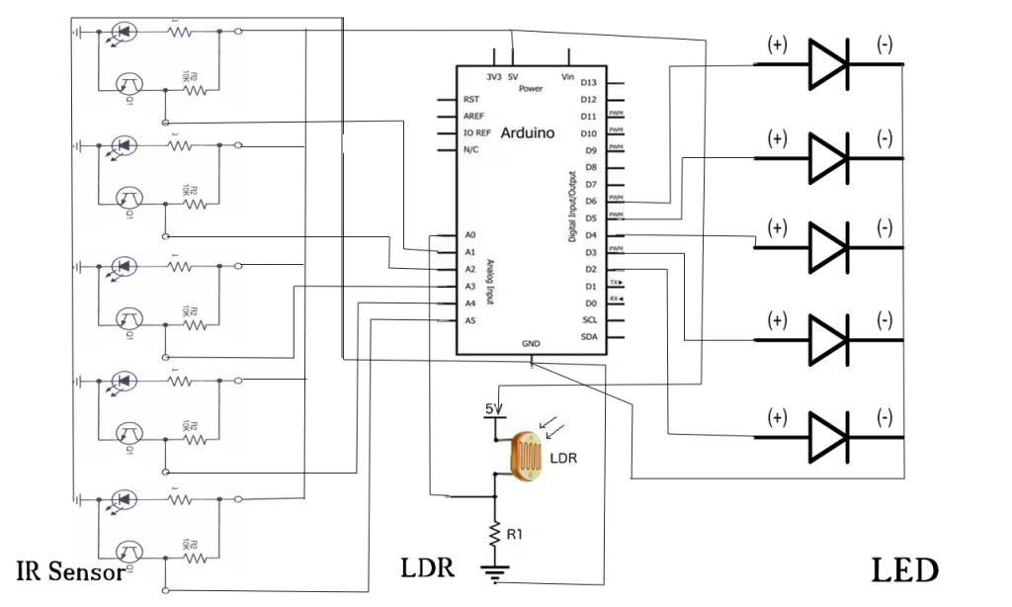
Schematic Circuit Diagram
The circuit contains 5 IR sensors, 1 LDR, an Arduino UNO R3 board, 5 LEDs, connecting wires

Slide 14
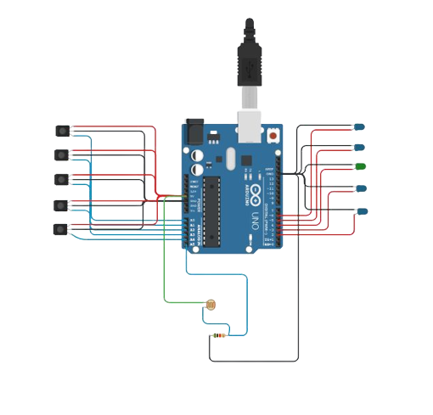
Circuit Diagram
Innovative Circuit Design for Efficient and Cost-Effective Lighting Solutions

Slide 15


Comparison of Average Cost versus Savings over 10 Years for per km
Parameter
Grid Electricity
Solar Energy
Cost Savings
Total Electricity Consumed (kWh)
14,400
7,200
-
Cost of Solar System (INR)
N/A
2,00,000
-
Cost of Generating Electricity (INR)
7,88,400
36,000
7,52,400
Maintenance Cost (INR)
1,00,000
50,000
50,000
Total Cost (INR)
8,88,400
2,86,000
6,02,400

Slide 16



Task Force
Gopu Akshitha
Sharath Harikumar
Praise Paul
21BCE7604
21BCE8104
21BCE7391

